Slide 1

Online Restaurant Analysis
(Swiggy)

Slide 2
INTRODUCTION ☹ (About the student) :
Hello, my name is Ravulapalli Sairam. I hold a Bachelor's degree in Information Technology from BV Raju Institute of Technology, with a commendable CGPA of 8.18.
Throughout my academic tenure, I have studied a wide range of IT subjects, including Artificial Intelligence, Machine Learning, Deep Learning, Python, Big Data, and more.
Why Data Science? :
I am keen on learning Data Science due to its immense potential to generate valuable insights from large and complex data sets. By mastering this field, I can utilize statistical techniques, machine learning algorithms, and programming skills to develop solutions that address real-world problems.
As an aspiring data professional, I am also motivated by the high demand for skilled Data Scientists in various industries and the opportunity to contribute to innovative projects that have a positive impact on society
Experience :
As a Software Intern at Aptean, I gained practical experience in software development through projects involving coding, debugging, testing, and documentation. This helped me sharpen my technical skills with programming languages such as Java, Python, and SQL, while Agile methodology and teamwork improved my interpersonal and collaborative abilities

Slide 3
WEB SCRAPPING :
As a first step, we are getting the URL of an Swiggy’s website which is used to scrape the website.
Now, Importing the relevant libraries.
Now, send the http request to the website or the Swiggy’s URL, in the next step we get a response has a http code(if the code is 200, the response is ok).
As per the requirement we can get the whole html element from the website.
As a next step , we have to extract the relevant content using the BeautifulSoup or Selenium webdriver.
As a next step, we have to extract the relevant information like restaurants name, types of food, ratings, price and discount.

Slide 4
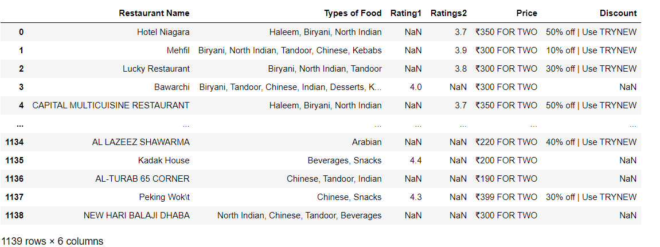
UNCLEANED DATA FRAME

Slide 5
As a next step, the collected gathered information is converted
into the dataframe.
Then converting the dataframe into the .csv format.
Exploratory Data Analysis :
Data Cleaning Steps –
In this step, we have to see some observations like
Removing the special characters from the column names.
Removing Incorrect named Headers.
Converting the required data types of columns.
Removing the duplicates
Removing unnecessary data
Handling the outliers

Slide 6
Data Manipulation Steps --
In this step, we have to see some observations like
Sorting of the required data
Aggregation of the data
Grouping the similar data in to single, if required.
Joining or Merging the data if it’s required.
Reshaping the Whole data

Slide 7
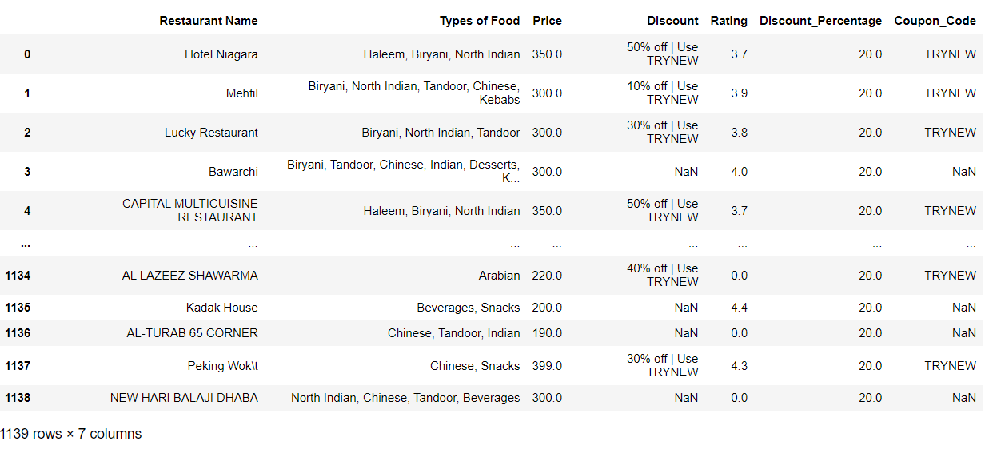
CLEANED DATA FRAME

Slide 8
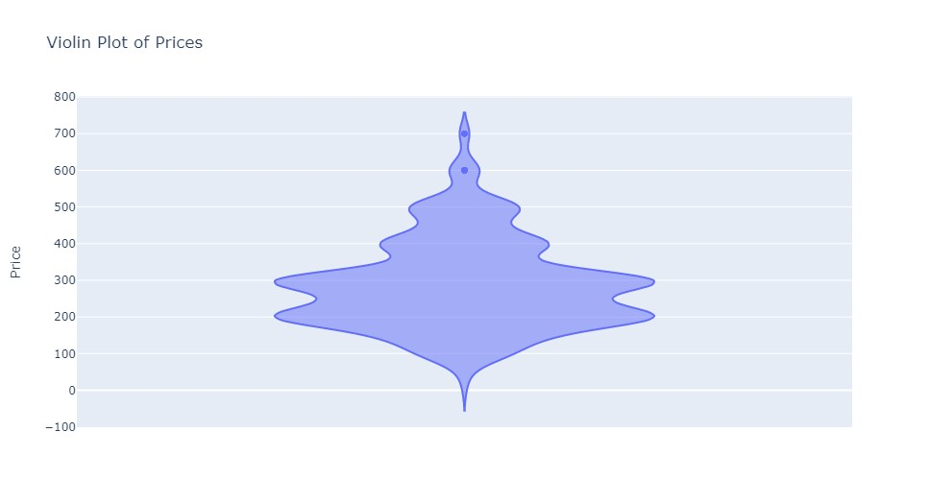
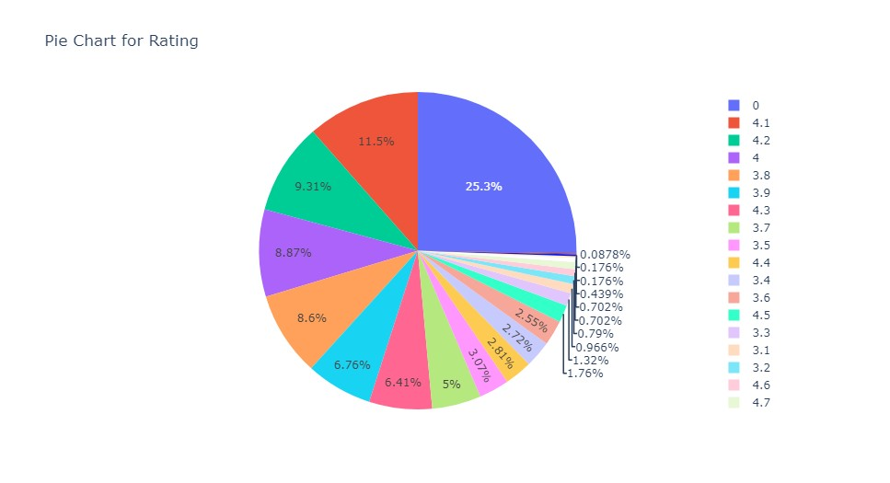
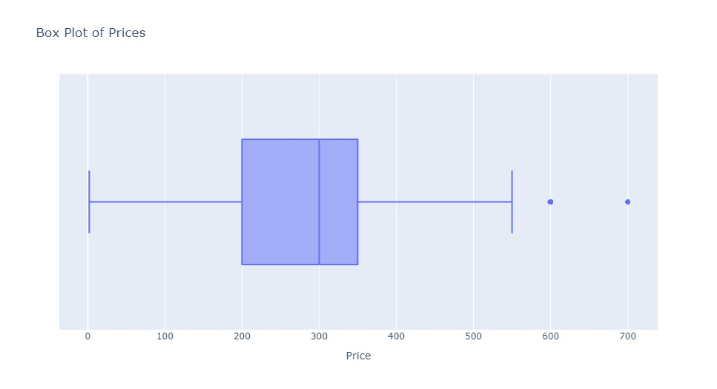
Univariate Analysis
Calculate the measures of central tendency (mean, median, mode) and measures of variability (range, standard deviation, variance, etc.) to summarize the variable.

Slide 9
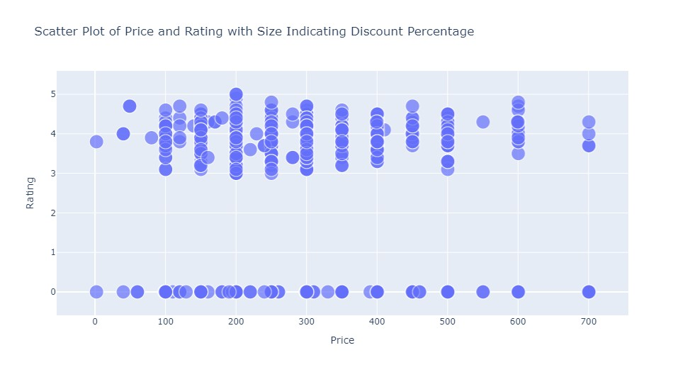
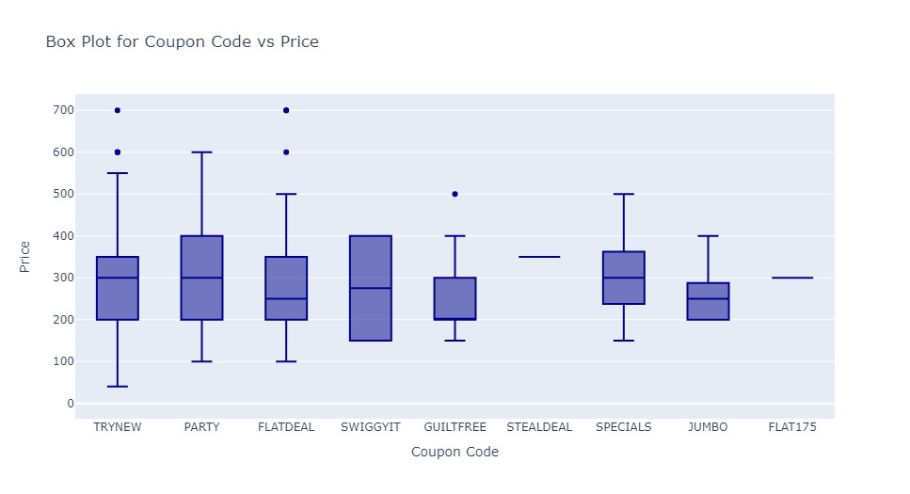
Bivariate Analysis
Bivariate analysis is a statistical analysis technique that involves analyzing the relationship between two variables to determine their degree of association or correlation.

Slide 10
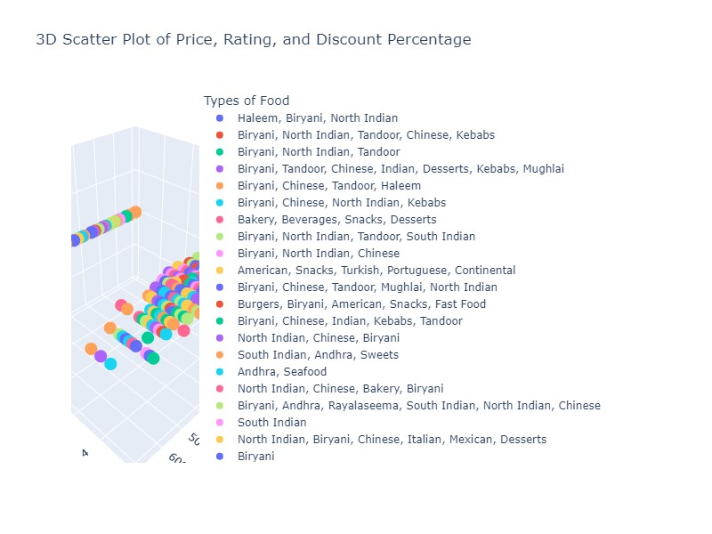
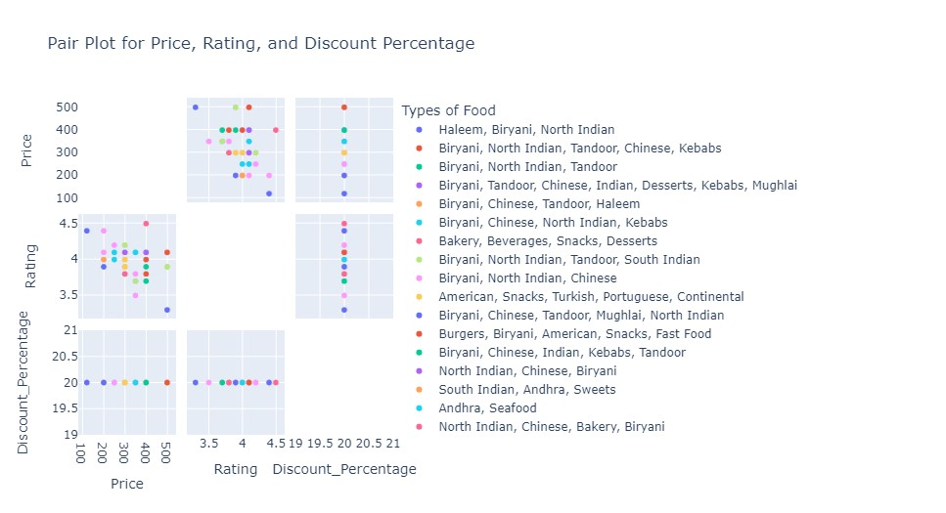
Multivariate Analysis
Multivariate analysis is a statistical analysis technique used to analyze data that involves multiple variables or features. In this type of analysis, the relationship between several variables is examined simultaneously, allowing for a more comprehensive understanding of the data.

Slide 11
Key Business Questions
What types of food are most popular among customers, and how does this vary by restaurant and price range?
Is there a correlation between discounts offered and restaurant ratings, and if so, what is the nature of this relationship?
Which restaurants have the highest ratings, and what factors contribute to their success?
Are there any trends in customer preferences over time, and how can restaurants adapt to these changes?
Can we identify any opportunities to increase customer retention and loyalty through targeted promotions or discounts?
Can we predict the success of a new restaurant opening based on its features and characteristics compared to existing restaurants in the area?

Slide 12
Experience/Challenges working on Web Scraping – Data Analysis Project
One of the biggest challenges is to extract the data from the websites, as some websites may have anti-scraping mechanisms in place or may have a complex structure that makes it difficult to extract data. Another challenge is to clean and preprocess the data after it has been extracted, as it may contain errors, missing values, or inconsistent formats.
Another challenge is to identify the relevant features or variables that will help to solve the business problem. Sometimes, there may be too many features or irrelevant features, which can make it difficult to focus on the key variables that are important for the analysis.
Finally, data analysis and visualization require expertise and a good understanding of statistical methods and tools. It is important to choose the appropriate methods and techniques to draw meaningful insights from the data, and to communicate the results effectively to stakeholders.
Overall, web scraping and data analysis projects can be challenging, but also very rewarding in terms of the insights and value they can provide to businesses and organizations.

Slide 13
Summary of the Data :
The project involves scraping data from food delivery platforms like Zomato and Swiggy, cleaning and analyzing the data to draw insights related to ratings and gross income. The first step involves defining the problem statement and identifying relevant websites to extract the data.
A minimum of 6 features and 1100 rows are scrapped. The extracted data is then converted to a dataframe and exported to a CSV file. The data is then imported and cleaned by removing special characters, correcting headers, and converting data types. Missing values and outliers are also treated.
The data is then analyzed and visualized using uni-variate and bi-variate methods. The final step involves interpreting the findings and drawing meaningful insights from the data.

Slide 14
Conclusion :
The maximum price of the food is about Rs.700 from the analysis of the whole project.
The best Type of the food is American and Pizzas With the ratings of
(4.6-5.0) from the whole analysis.
As some of ratings are high in restaurants , but the quality and quantity
of the food is not good(as per the user analytics & reviews) and
vice – versa in some situations from the user and project analysis.
As per different statistics and other factors, there are mainly different coupons for restaurants.

Slide 15


Slide 16

THANK YOU

